Slide 1
Global epidemiology of drug use: indicators and challenges
Chloé Carpentier
Drug Research Section, Chief
UNODC
Virtual Conference on Drug Demand Reduction in Africa, Plenary 4: Epidemiology and its Role in Drug Demand Reduction, 20 October 2020

Slide 2
Why drug use epidemiology?
to support evidence-based responses to drug use
Develop policies and programmes (interventions)
Evaluate the outcome and impact of policies and programmes
Allocate resources to priority areas
Contribute to international monitoring and policy debate

Slide 3
Why drug use epidemiology?
to generate reliable information for policies & programmes
Identify existing drug use patterns
  Type of drugs, by whom, what ways
Monitor changing trends in patterns
  Over time, geographic area and population groups
  Detecting new drugs, methods of use
Determine health and social consequences of drug use

Slide 4
Monitoring the SDGs – Goal 3
  Goal 3 – Ensure healthy lives and promote well being for all at all ages
  Target 3.5 – strengthening the prevention and treatment of substance abuse including narcotic drug abuse
  Indicator – number of people provided drug treatment services / estimates of people with drug use disorder (= in need of treatment)

Slide 5
THE CONCEPTUAL FRAMEWORK

Slide 6
Key epidemiological indicators of drug use – Lisbon consensus, CND 2000
Extent of drug use (prevalence and incidence in the
general population
youth population)
Population/school surveys
High risk drug use
(e.g. more regular drug users, those injecting drugs, those with drug use disorders)
Focused Assessments / indirect estimation methods
Registers administrative data
Treatment demand
Drug related morbidity (HIV, HCV, TB, mental health, etc.)
Drug related mortality
Registers administrative data

Slide 7
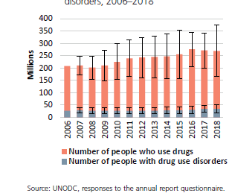
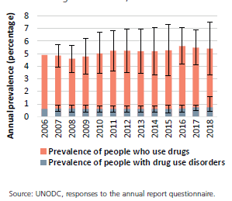
Number of drug users on the rise
2018
269 million people used drugs in the past year or 5.4% of 15-64
35 million people with drug use disorders or 0.7% of 15-64
Number of people who use drugs and people with drug use disorders, 2006–2018
Prevalence of drug use and drug use disorders, 2006–2018

Slide 8
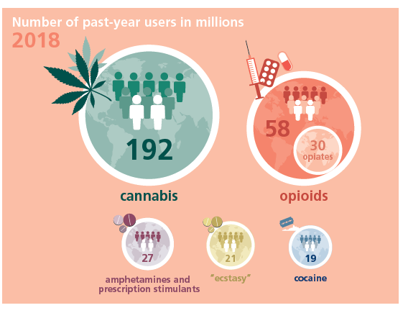
Estimates of global numbers of people using drugs 2018

Slide 9
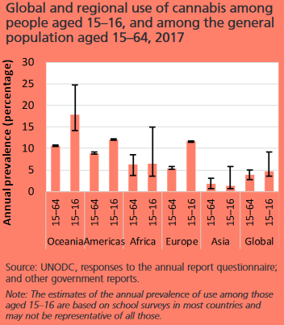
Cannabis use higher in youth

Slide 10
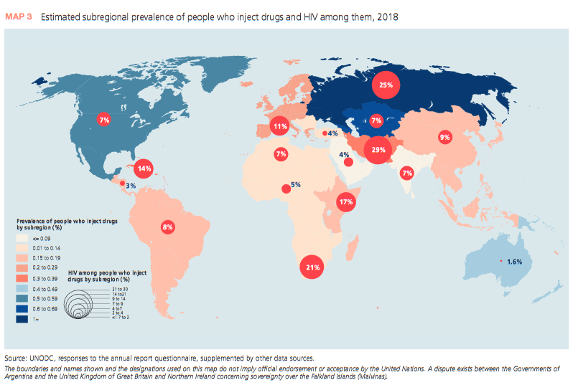
11.3 million people who inject drugs, one eight living with HIV

Slide 11
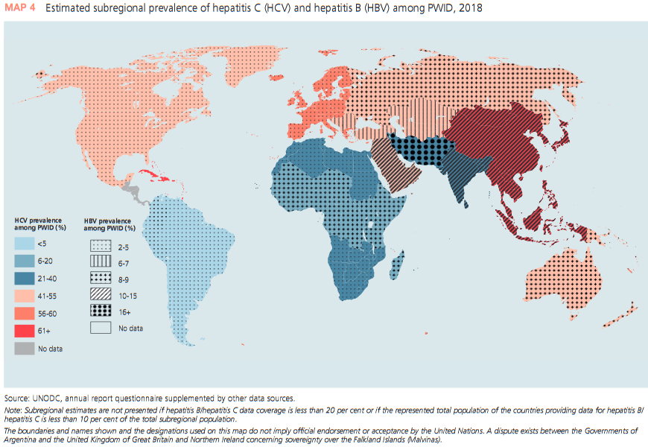
Half people who inject drugs are living with hepatitis C
And

Slide 12
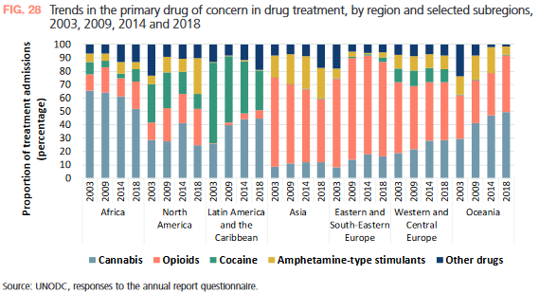
Increase in cannabis use disorders in people in drug treatment

Slide 13
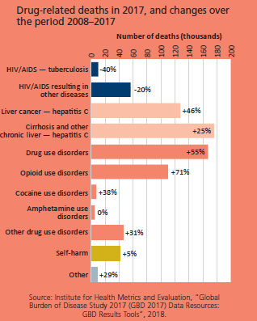
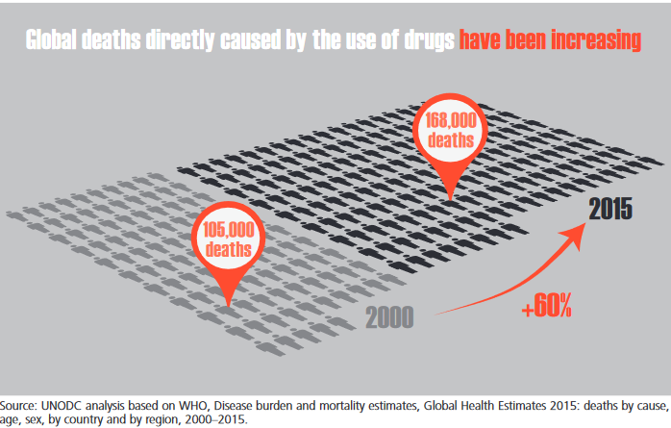
585,000 drug related deaths, half due to hepatitis C

Slide 14
Drug use: epidemiological indicators and responses
Registers
treatment, morbidity, mortality
Known
drug users
High risk users
Dependent users
Drug use disorders
Current users (past 30 days)
Recent users (past 12 months)
Ever used a substance (lifetime)
Aftercare
Treatment
Harm reduction
Focused assessments
(size estimation by indirect methods)
Screening and brief intervention
Surveys
general population
schools/youth
Prevention

Slide 15
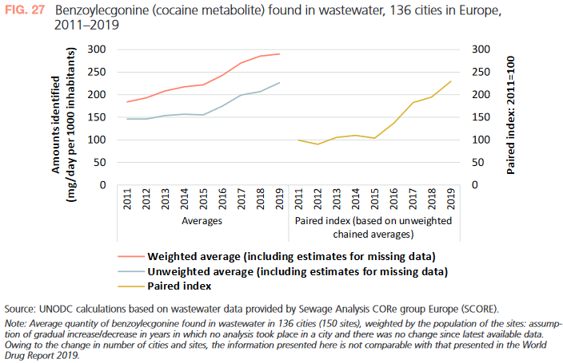
Emerging drugs and trends in patterns of use
Case reporting
Emergency room visits
Community-based services (outreach, drop-in services)
Forensic services
Police
Treatment services
Consumption of drugs
Waste water analysis

Slide 16
Drug use among vulnerable populations
Population groups that are especially impacted by socioeconomic inequalities resulting from drug use disorders
  Indigenous populations
  Immigrants
  Displaced populations
  Women
  Children
  Sexual minorities
  Sex workers
  People in prison
  Homeless people
No international consensus on vulnerable populations neither on how to monitor drug use among these groups

Slide 17
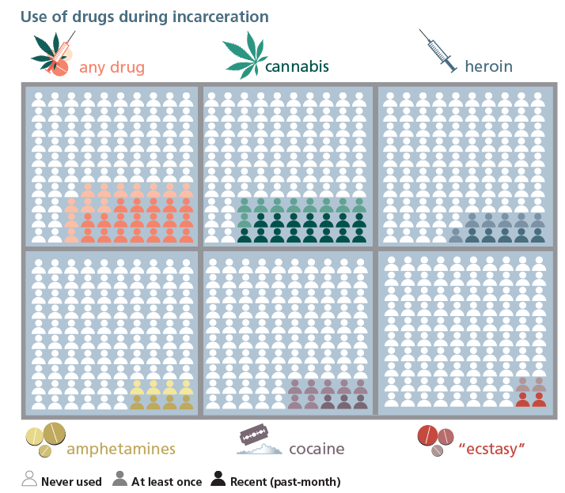
Drug use in prison
Any drug
31% at least once
19 % past month

Slide 18
Inter Agency Technical Working Group on Drug Epidemiology – IATWG-DE
UNODC-WHO led + African Union, EMCDDA, OAS/CICAD
For strategic partnerships and better coordination and harmonization of efforts in drug epidemiology, 2016
  Identify major gaps and challenges for producing the global & regional/subregional estimates on drug use and its health and social consequences
  Discuss current approaches, major data gaps and challenges for reporting on SDG target 3.5
  Identify key priorities for collaboration
  Discuss and identify roles and responsibilities of the organizations to address key priorities for international collaboration

Slide 19
Thank you for your listening!

