Slide 1


Slide 2


Background
Global NGO
With over 17,000 members
Supports the development of a professional workforce in the substance use prevention, treatment and recovery fields
Promotes evidence-based and high quality practice, policy and research in prevention, treatment and recovery
Acts as a central point – bringing people together

Slide 3



Funded by the U.S. Department of State’s Bureau of International Narcotics and Law Enforcement Affairs (INL).
Originated from a group calling for coherence and collaboration in the field:
U.S. Department of State’s Bureau of International Narcotics and Law Enforcement Affairs (INL)
Colombo Plan - Drug Advisory Programme (DAP)
United Nations Office on Drugs and Crime (UNODC)
World Health Organization (WHO)
Inter-American Drug Abuse Control Commission (CICAD - OAS)
Applied Prevention Science International (APSI)
African Union
European Drug Monitoring Centre (EMCDDA)
Canadian Centre on Substance Abuse (CCSA)
Notes:
ISSUP is funded by U.S. Department of State’s Bureau of International Narcotics and Law Enforcement Affairs (INL).
The concept originated in the meeting of a group pulled together by INL. This group (listed here on the slide) called for coherence and collaboration in the field.
This concept was developed by INL, and the International Society of Substance Use Professionals was born.
Our network of partners has continued to grow.

Slide 4
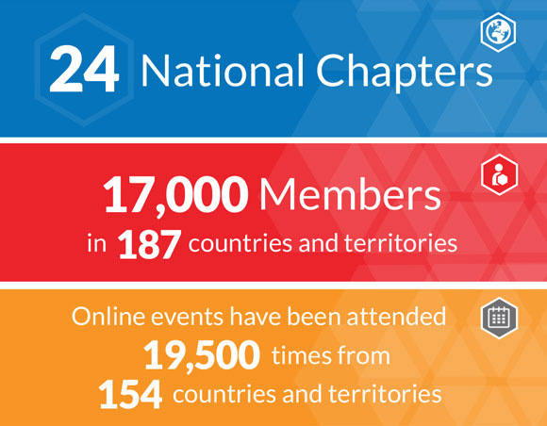

Slide 5
ISSUP Vision
To create a connected, trained, knowledgeable, and effective international network of substance use prevention, treatment and recovery support professionals undertaking and promoting high-quality, evidence based, and ethical substance use prevention, treatment and recovery support.

Slide 6
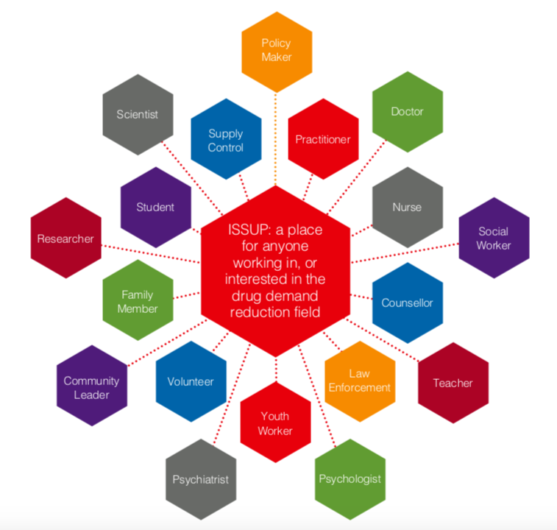
Notes:
ISSUP wants to put this workforce on the map!
To help the world see the importance of this field working together as a workforce, and to help the workforce recognize their contributions.
We at ISSUP consider ANYONE working in, studying or interested in drug demand reduction to be part of this field. We include volunteers, family members, support workers, researchers, education professionals, social work professionals, medical professional, criminal justice systems, mental health workers etc. etc. The list goes on and on, and I am sure I have missed mentioning someone! But, my point is that we are inclusive, and want everyone to recognize the parts they play in drug demand reduction.

Slide 7
Connections…
Practice
Policy
Research
Notes:
We exist to enhance the listening between groups.

Slide 8



Notes:
ISSUP has a special place within a family of organisations all working together and with INL to ensure effective, evidence based, ethical work is being undertaken.
The International Consortium of University for Drug Demand Reduction endorses and support further education institutions to deliver drug demand reduction education programmes within their institutions.
The Global Center for Credentialing and Certification supports the workforce in achieving that mark of recognition for the knowledge and experience they have.
We also work with HealtheKnowledge, Colombo Plan, CICAD and UNODC in the delivery of the Universal Curricula – a product envisaged and supported by INL.

Slide 9


Membership levels
Student Membership | Regular Membership
Attending an educational institution (any field) or attending training with drug demand reduction within their field of interest | An interested, non-professional applicant (can include volunteers, family members or non-accredited community members)
Professional Membership | Drug Demand Reduction Professional Membership
This category is for those that are undertaking a role that makes a contribution to the drug demand reduction field, even if not necessarily a specialist or 100% dedicated to that activity. This includes professions such as Social workers, Religious leaders, Medical profession, Teachers, Youth workers, Community workers and Academics etc. | This level of membership is for those who have specific qualifications, expertise and experience directly linked to the drug demand reduction field.

Slide 10

How do we work?
ISSUP delivers through 3 channels:
DIGITAL
Website: www.issup.net
Social media
Newsletter
ISSUP EVENTS
An international conference offering training and networking opportunities, and regular online events
ISSUP NATIONAL CHAPTERS
Locally accessible knowledge, networks and exchange. Bringing people together in country.

Slide 11
Website
English, Arabic, French, Spanish, Portuguese
Knowledge Share
Networks
Professional Development
Events and Webinars
National Chapters
My ISSUP
ISSUP news / information
Notes:
The ISSUP website is our ‘home’.
The place where we contain everything! It is made up of 7 sections, and allows ISSUP to deliver key benefits to visitors and members alike.
We were very fortunate to exist online, so we had the platform to enhance when the lockdown happened.
2020:
3,368 items added to the Knowledge Share
1,038 events posted on the calendar
1,560 network posts in group discussions
In Arabic, English, French, Portuguese & Spanish
Visitor numbers increased by 50%
Surveyed last year to ensure we’re meeting the ends of our users, and are implementing those changes.
Within our Knowledge Share and our Networks we have grouped items that are related to the challenges we’re working within. There’s a link from the homepage to the network.

Slide 12
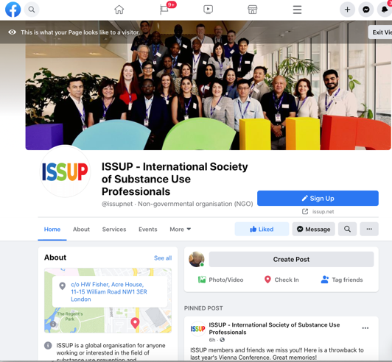
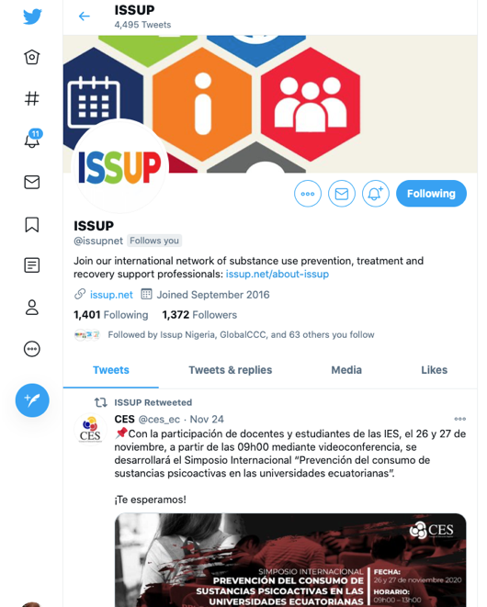
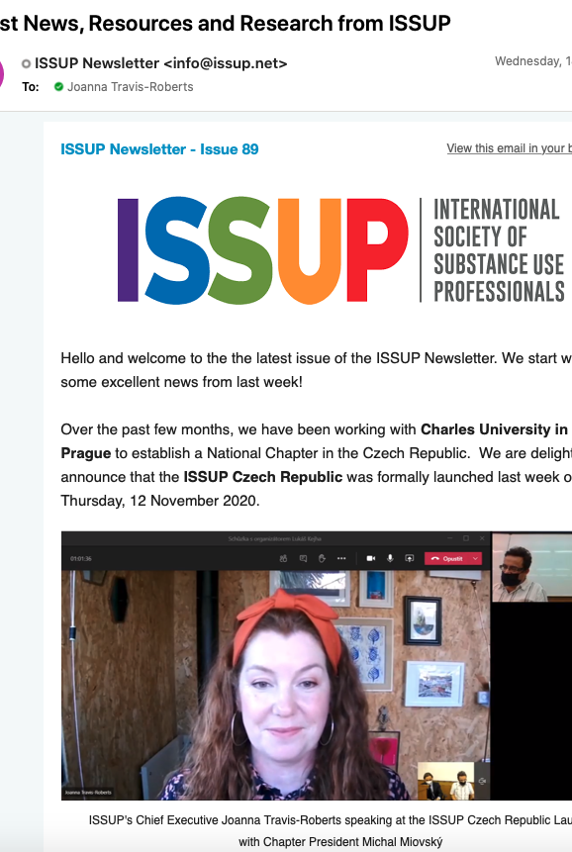
ISSUP… online
Notes:
As well as our website, we are online via our email newsletter, social media accounts and online events

Slide 13
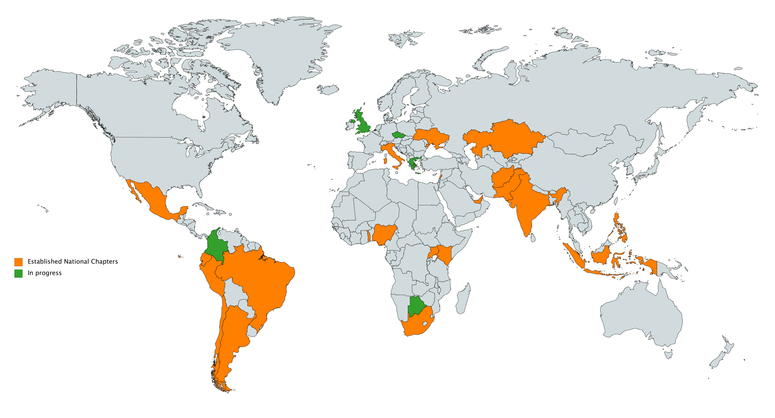
Afghanistan
Argentina
Brazil
Chile
Czech Republic
Ecuador
Greece
India
Indonesia
Italy
Kazakhstan
Kenya
Lebanon
Mexico
Nigeria
Pakistan
Peru
Philippines
South Africa
Togo
Uganda
Ukraine
UAE
UK
Notes:
National Chapters allow ISSUP to deliver its mission at a local level within the relevant language, culture and context. This has become even more important during covid, when each country was faced with their own lockdown circumstances, and country specific challenges. The national provision allows us to tailor and adapt for each national workforce.
Some National Chapters are undertaking their own independent activities to strengthen the workforce, some are allowing the local network to connect with the global ISSUP activities and membership.
24 established National Chapters
4 ‘in process’

Slide 14
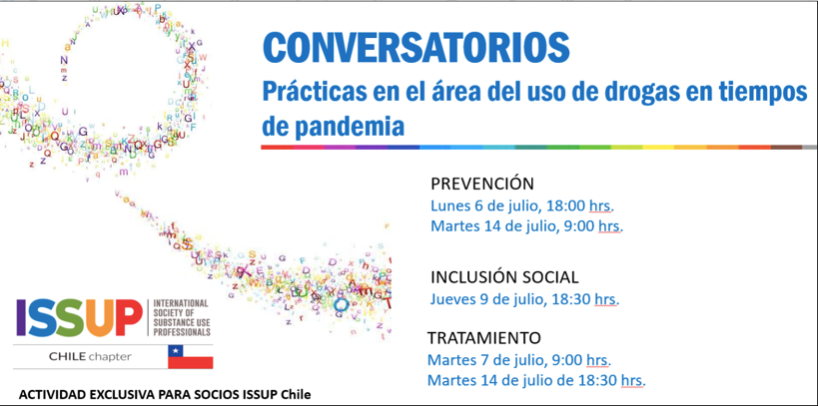
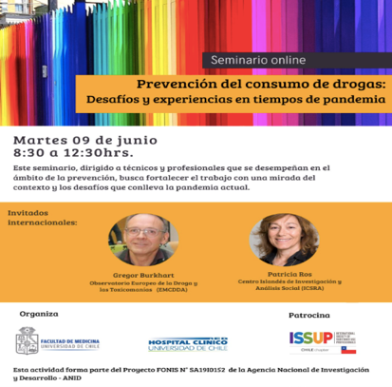
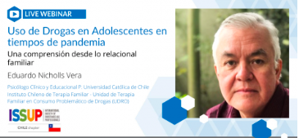

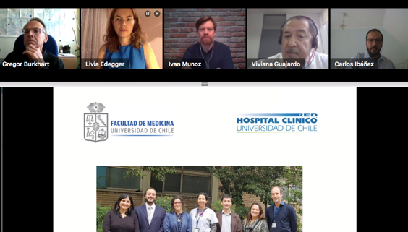

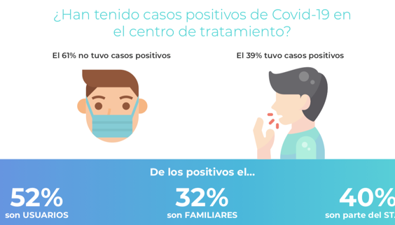
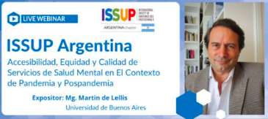
Notes:
There are a range of NC activities: training, webinars, meetings, focused newsletters. National Chapters have accessed our platforms of the website, social media and webinars to undertake their activities online.

Slide 15
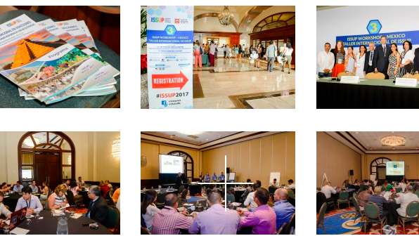
ISSUP Event
Thailand 2015
Brazil 2016
Mexico 2017
Kenya 2018
Austria 2019
Africa 2020 – First virtual conference
Abu Dhabi 2022
Notes:
ISSUP events have taken place around the world since 2015. These in person events allow us to build networks, share expertise, share the latest research and provide training. Key International organisations attend to undertake activities within the event.
We are excited to be planning our next ‘outing’ in Abu Dhabi, February 2022, where we will blend our learning from our online reach, with our experience of holding in person events.

Slide 16
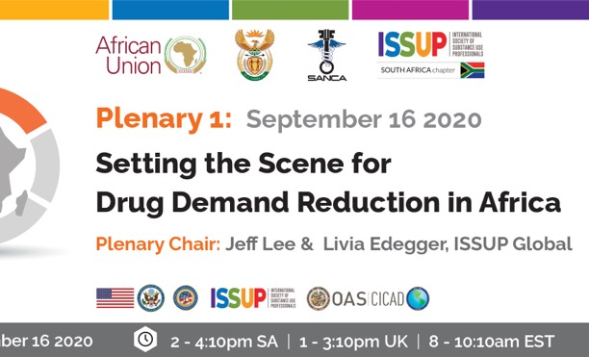

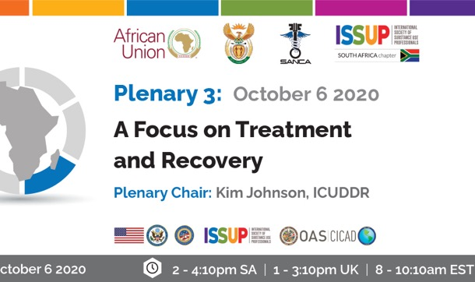
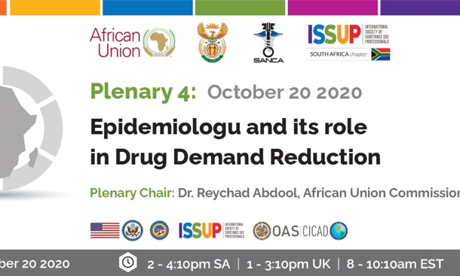
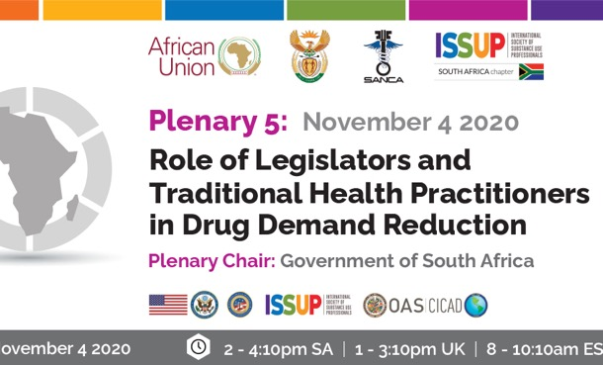

1st Virtual Conference
Drug Demand Reduction in Africa
Sept 16 - Nov 10, 2020
Simultaneous interpretation in
Arabic, French, Spanish, Portuguese
Partners:
ISSUP South Africa
SANCA
African Union
Department of Social Development, Republic of South Africa
INL
CICAD
Notes:
Moving online… we have moved our events online for now. But are delighted by the reach we have been able to have, and how interested members are to join these online events. We’re looking forward to continuing to develop new online concepts, like this regional event held in collaboration with ISSUP South Africa and key partners.

Slide 17
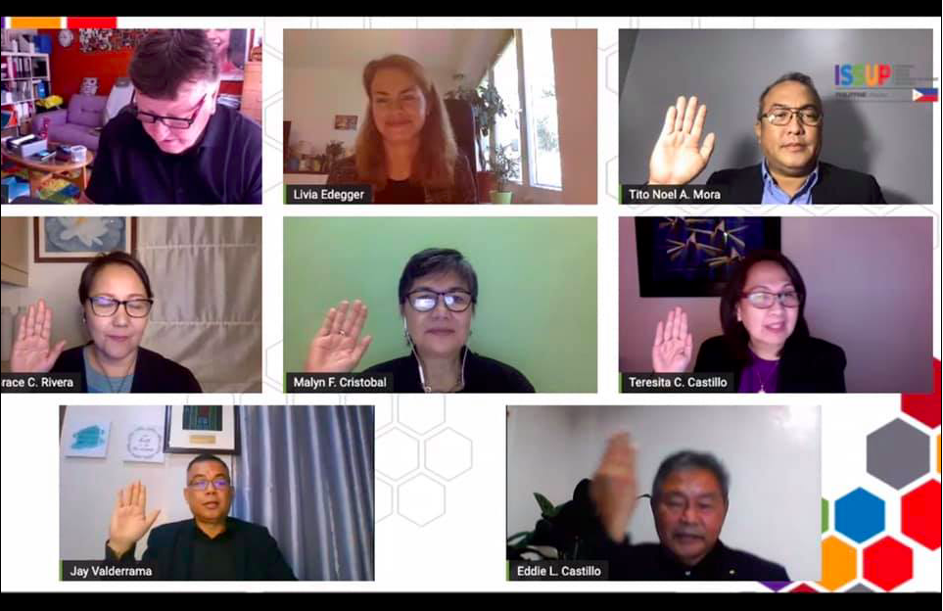
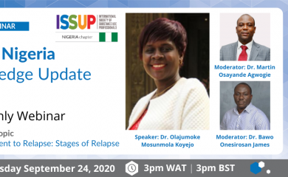

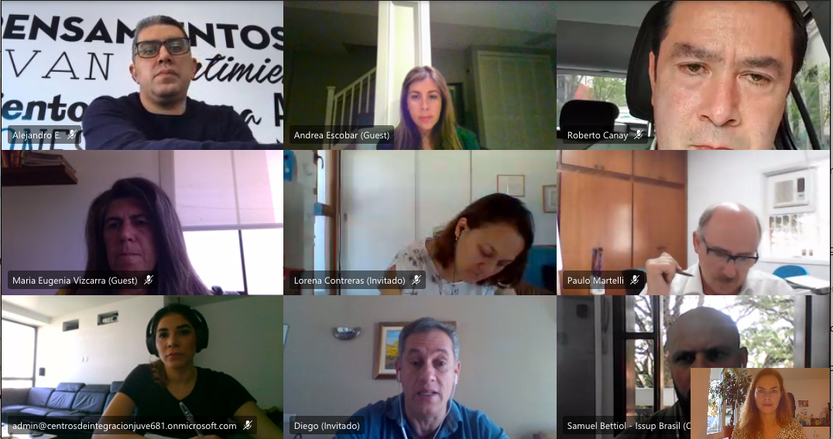
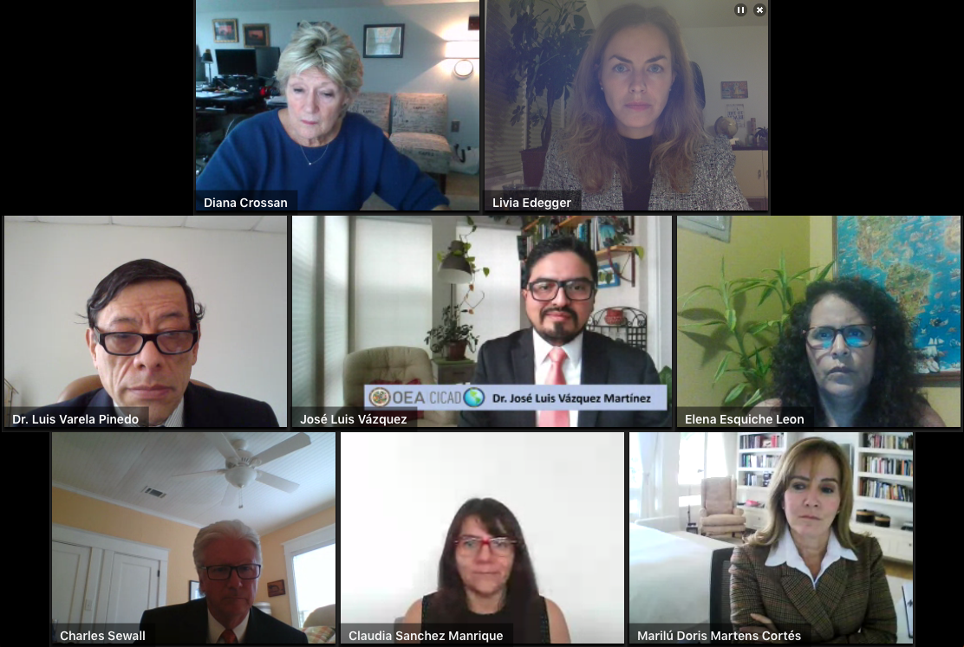
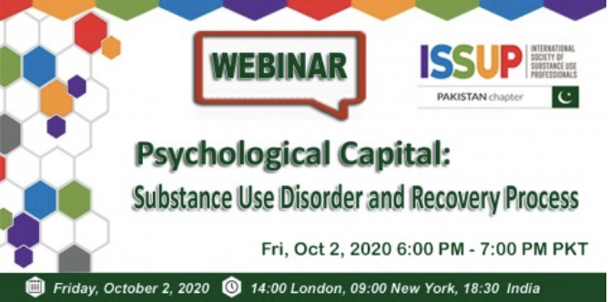
67 online events by ISSUP and our National Chapters
19,429 participants from 153 countries
Online events in multiple languages
On multiple platforms – hosted by ISSUP and on social media
All events recorded, and added to the website as resources
A selection of topics, including:
  Prevencion del consumo de Drogas
  Motivational Interviewing
  Mental Health During the Covid-19 pandemic
  Supporting the families of substance users
  Adolescent brain development
  Family based interventions
  Prevalence of SUD’s in Asia
  Justicia Terapeutica

Slide 18

Keep in touch
Please join and share with your networks
www.issup.net
Facebook.com/issupnet
Twitter - @issupnet
Linkedin – issup
Joanna Travis-Roberts
Chief Executive
joanna.travis@issup.net
Notes:
Join us, talk to us, connect with each other.
Thank you.

